Slide 1


2021
Search Engine and Big Data

Slide 2
Search Engine and Big Data
Chapter 1- Introduction
Prof. Shunxiang Zhang
Anhui University of Science & Technology
Computer Science and Engineering
Mobile Phone：189-6377-7827
Email：sxzh666@gmail.com;sxzhang@aust.edu.cn

Slide 3
4 Learning Resources
Bibliographic Database
ACM/IEEE/Springer/Elsevier/Wiley/Inderscience/IGICNKI.
PS. dl.acm.org
Baidu Scholar/Google Scholar
Dblp: computer science bibliography
http://dblp.org/
en.wikipedia.org https://en.wikipedia.org/wiki/Main_Page

Slide 4
Score proportion of this course
Attendance(15%)
full attendance
Oral presentation(15%)
Using Slides/ppt; especially do application system
Examination(70%)
close-book

Slide 5
Topics covered/Contents
Search Engine Architecture
Data crawling system
Content indexing system
Content retrieve system
Link analysis system
Processing technique
for Big Data

Slide 6
Chapter 1- Why we focus on search engines?
1
The most important Application system on the Internet.
2
The largest information distribution platform in human history
3
An important platform for technological research and development
3
3
4
Profitable "business" in the economic
4
4

Slide 7
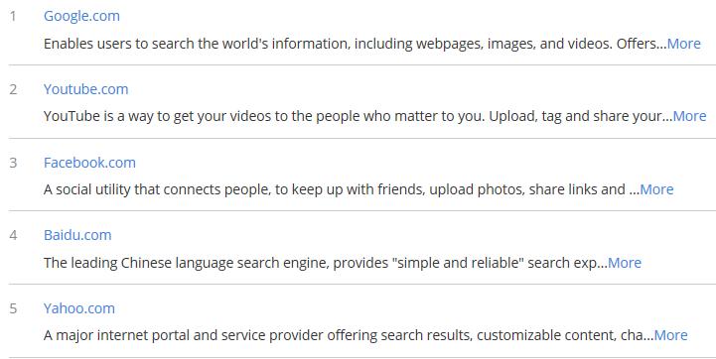
http://www.alexa.com/

Slide 8
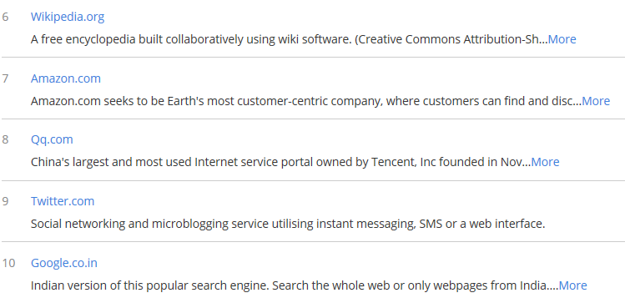
http://www.alexa.com/

Slide 9
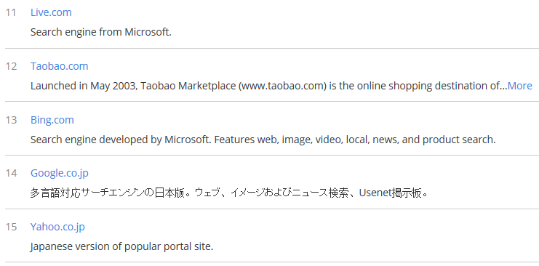
http://www.alexa.com/
Actually, Search engine is the main way for users to obtain information

Slide 10
Chapter 1- Why we focus on search engines?
1
The most important Application system on the Internet.
2
The largest information distribution platform in human history
3
An important platform for technological research and development
3
3
4
Profitable "business" in the economic
4
4

Slide 11

The importance of search

Slide 12
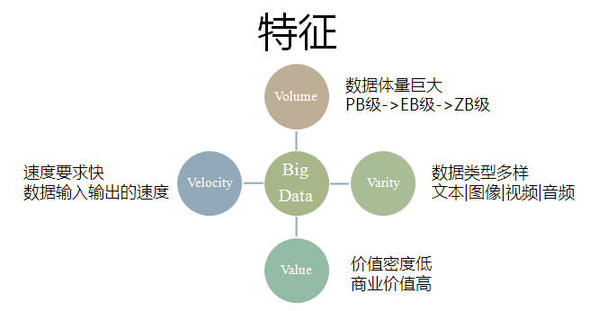
Volume：GB、TB、PB、EB、ZB
Variety： Web logging, social media, Internet search, mobile phone call records and sensor, network and other data types
Velocity： High speed describes the speed at which data is created and moved
Value： A lot of unrelated information, but it likes the precious sand in the waves.

Slide 13
Problem
Limited attention (cognitive ability), it takes a lot of time to find information
solution
Collecting information through the Internet
Building a Digital platform for the Real World

Slide 14
Chapter 1- Why we focus on search engines?
1
The most important Application system on the Internet.
2
The largest information distribution platform in human history
3
An important platform for technological research and development
3
3
4
Profitable "business" in the economic
4
4

Slide 15
Two important conferences
World Wide Web conference-The Web Conference 2019 (formerly known as WWW2019). The conference will take place in San Francisco, CA, USA from May 13 to May 17, 2019, and will celebrate the 30th anniversary of the Web.
IEEE conference on big data
Search engine is the main tool in every field-Baidu academic search
SCI Partition ：http://www.letpub.com.cn/
Web of Science

Slide 16
Conferences of Two related fields
First : Artificial Intelligence
AAAI: AAAI Conference on Artificial Intelligence
NeurIPS: Annual Conference on Neural Information Processing Systems
ACL: Annual Meeting of the Association for Computational Linguistic
CVPR: IEEE Conference on Computer Vision and Pattern Recognition
ICCV: International Conference on Computer Vision
ICML: International Conference on Machine Learning
IJCAI： International Joint Conference on Artificial Intelligence

Slide 17
Conferences of Two related fields
Second : Database/ Data Mining/ Information Retrieval
SIGMOD： ACM Conference on Management of Data
SIGKDD： ACM Knowledge Discovery and Data Mining
ICDE： IEEE International Conference on Data Engineering
SIGIR： International Conference on Research on Development in Information Retrieval
VLDB： International Conference on Very Large Data Bases

Slide 18
Chapter 1- Why we focus on search engines?
1
The most important Application system on the Internet.
2
The largest information distribution platform in human history
3
An important platform for technological research and development
3
3
4
Profitable "business" in the economic
4
4

Slide 19
Advertising revenue
Ranking: enterprise ranking, website ranking and sale keywords to advertiser.
conclusion
search engines can help understand the world.
We can publishing our information on the internet. More importantly, we can get those information by using search engine, Google, Baidu, to satisfy our information requirements.

Slide 20
Chapter 2- Basic Concepts and Development History
1
The Development of The Internet and the World wide Web
2
Development history
3
Definition and running principle
3
3

Slide 21
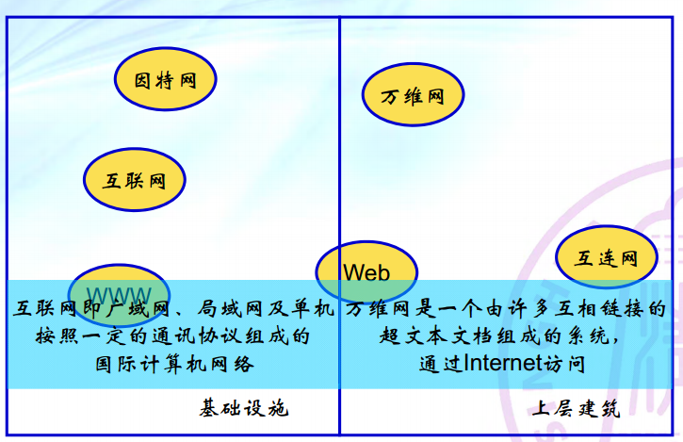
Relation between internet and WWW
互联网是基础设施infrastructure ；
万维网是上层建筑superstructure ；

Slide 22
Chapter 2- Basic Concepts and Development History
1
The Development of The Internet and the World wide Web
2
Development history
3
Definition and running principle
3
3

Slide 23
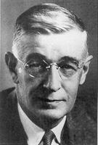
Vannevar Bush- Father of Internet
Vannevar Bush, (born March 11, 1890, Everett, Mass., U.S.—died June 28, 1974, Belmont, Mass.), American electrical engineer and administrator who developed the Differential Analyzer and oversaw government mobilization of scientific research during World War II.

Slide 24
Vannevar Bush
Education
The son of a Universalist minister, Bush received his bachelor’s and master’s degrees in mathematics from Tufts College (Medford, Massachusetts) in 1913. Following a sequence of teaching and electronics jobs, he returned to graduate studies and, in 1916, received a doctorate in electrical engineering that was awarded jointly by the Massachusetts Institute of Technology (MIT), then located in Boston, and Harvard University, in nearby Cambridge. Bush returned to Tufts as an instructor in the fall of 1916 and soon became involved in antisubmarine research. A submarine-detection device that he invented during World War I was not adopted by the U.S. Navy, probably owing to Bush’s lack of access to government policy makers—an obstacle he would rectify in the next war.

Slide 25
Vannevar Bush
Education
The son of a Universalist minister, Bush received his bachelor’s and master’s degrees in mathematics from Tufts College (Medford, Massachusetts) in 1913. Following a sequence of teaching and electronics jobs, he returned to graduate studies and, in 1916, received a doctorate in electrical engineering that was awarded jointly by the Massachusetts Institute of Technology (MIT), then located in Boston, and Harvard University, in nearby Cambridge. Bush returned to Tufts as an instructor in the fall of 1916 and soon became involved in antisubmarine research. A submarine-detection device that he invented during World War I was not adopted by the U.S. Navy, probably owing to Bush’s lack of access to government policy makers—an obstacle he would rectify in the next war.

Slide 26
Vannevar Bush
Legacy
In a career that extended from the era of electrification to computers and electronic devices, Bush played a seminal role in transforming American science. When Bush began his career at MIT in 1919, solving the difficulties in constructing the nation’s electric-power network was paramount, and private foundations were the dominant patrons of American scientific research. By the time he died in 1974, consumer electronic devices and computers were ubiquitous, and the U.S. government, especially the armed services, had become the major patron of American scientific research.
Today Bush is also remembered as a prophet in another field, computer science. In a 1945 article entitled “As We May Think,” published in the Atlantic Monthly, Bush proposed a device that he called the Memex—an indexed, archival, microfilm machine for cross-referencing and retrieving information. For Bush, this article was an extension of his work in analog computing and microfilm technology. To the modern reader it portends the creation of hypertext and the World Wide Web.

Slide 27
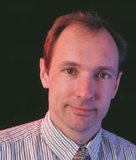
Tim Berners-Lee-Father of WWW
Sir Tim Berners-Lee invented the World Wide Web in 1989.
He is the Director of the World Wide Web Consortium (W3C), a Web standards organization founded in 1994 which develops interoperable technologies (specifications, guidelines, software, and tools) to lead the Web to its full potential. He is a Director of the World Wide Web Foundation which was launched in 2009 to coordinate efforts to further the potential of the Web to benefit humanity.
A graduate of Oxford University, Sir Tim invented the Web while at CERN, the European Particle Physics Laboratory, in 1989. He wrote the first web client and server in 1990. His specifications of URIs, HTTP and HTML were refined as Web technology spread.

Slide 28
Tim Berners-Lee-Father of WWW
He is the 3Com Founders Professor of Engineering in the School of Engineering with a joint appointment in the Department of Electrical Engineering and Computer Science at the Laboratory for Computer Science and Artificial Intelligence ( CSAIL) at the Massachusetts Institute of Technology (MIT) where he co-leads the Decentralized Information Group (DIG). He is also a Professor in the Computer Science Department at the University of Oxford, UK. He is President of and founded the Open Data Institute in London.

Slide 29
Tim Berners-Lee-Father of WWW
In 2001 he became a Fellow of the Royal Society. He has been the recipient of several international awards including the Japan Prize, the Prince of Asturias Foundation Prize, the Millennium Technology Prize and Germany's Die Quadriga award. In 2004 he was knighted by H.M. Queen Elizabeth and in 2007 he was awarded the Order of Merit. In 2009 he was elected a foreign associate of the National Academy of Sciences. He is the author of "Weaving the Web".
On 4 April 2017, Sir Tim was awarded the ACM A.M. Turing Prize for inventing the World Wide Web, the first web browser, and the fundamental protocols and algorithms allowing the Web to scale. The Turing Prize, called the "Nobel Prize of Computing" is considered one of the most prestigious awards in Computer Science.

Slide 30
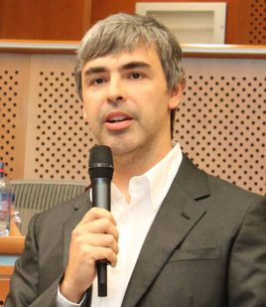
Larry Page -Lee-one founder of Google
Larry Page sits at the helm of Alphabet, the parent company of Google, healthcare division Calico, smart home appliance division Nest and more.
He cofounded Google in 1998 with fellow Stanford Ph.D. student Sergey Brin.
With Brin, Page invented Google's PageRank algorithm, which powers the search engine.
Page was Google's first CEO until 2001. After serving as president of products, he took the CEO job again in 2011.

Slide 31
Larry Page -Lee-one founder of Google
Page(Lawrence Edward Page), one of the founders of Google, officially became Google CEO on April 4, 2011.
in 2013, Larry Page was named 2013 America's most influential CEO, under the age of 40 and ranked 20th on Forbes 2013 Global Rich list with an asset of $23 billion .
October 2016, "Forbes" released the 400 Rich list of the United States, Larry Page ranked ninth.
on December 14, 2016, he was awarded the most influential CEO of 2016.
in June 2020, Page ranked 8th on the Forbes list of global billionaires with a wealth of $67.5 billion.

Slide 32
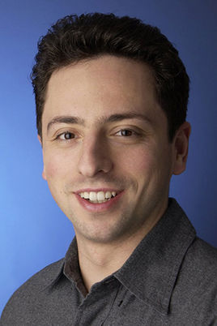
Sergey Brin -Lee-another founder of Google
Sergey Brin works as president of tech giant Alphabet, the parent firm of Google.
He previously ran the secretive Google X division, which made the ill-fated Google glasses.
Brin cofounded search engine firm Google with Larry Page in 1998.
Brin and Page met at Stanford University while studying for advanced degrees in computer science.
Google went public in 2004 and changed its name to Alphabet in 2015.

Slide 33
Sergey Brin -Lee-another founder of Google
He ranked 24th in 2011 with 19.8b. In October 2016, <Forbes>published the``American 400 Rich List'' and Sergei Brin ranked 10th. [1]In March 2019, Sergei Mikhairovic Brin ranked 7th in the Forbes Global 400 Rich List in 2019 with a wealth of 49.8b.
in June 2020, Forbes ranked 9th on the Forbes list of global billionaires with a wealth of $67.5 billion.
Bachelor's degree in mathematics and computer science

Slide 34
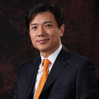
Li Yanhong –the founder of Baidu
李彦宏，男，汉族，无党派人士，1968年11月出生，山西阳泉人，百度创始人、董事长兼首席执行官，全面负责百度的战略规划和运营管理。
1991年，李彦宏毕业于北京大学信息管理专业，随后前往美国布法罗纽约州立大学完成计算机科学硕士学位，先后担任道·琼斯公司高级顾问、《华尔街日报》网络版实时金融信息系统设计者，以及国际知名互联网企业——Infoseek公司资深工程师。李彦宏所持有的“超链分析”技术专利，是奠定整个现代搜索引擎发展趋势和方向的基础发明之一。

Slide 35
Li Yanhong –the founder of Baidu
2000年1月，李彦宏创建了百度。经过十多年的发展，百度已经发展成为全球第二大独立搜索引擎和最大的中文搜索引擎。百度的成功，也使中国成为美国、俄罗斯和韩国之外，全球仅有的4个拥有搜索引擎核心技术的国家之一。2005年，百度在美国纳斯达克成功上市，并成为首家进入纳斯达克成分股的中国公司。百度已经成为中国最具价值的品牌之一。
One of only 4 countries in the world with the core technology of search engine

Slide 36
Chapter 2- Basic Concepts and Development History
1
The Development of The Internet and the World wide Web
2
Development history
3
Definition and running principle
3
3

Slide 37
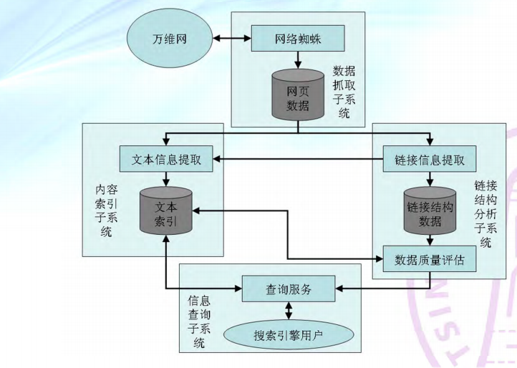
Search engine architecture

Slide 38
Core technology for SE
information indexing
Information retrieve
Distribution storage
User behavior analysis

Slide 39
Homework
Three questions:
What is the meaning of search engine for human beings?
What is the relationship between search engines and big data?
By retrieving some documents on the WWW, you can deepen your understanding of the following aspects. So, it can build a foundation for your future research.
Data acquisition, processing, storage, mining and application.

